Slide 1
PASSENGER POSITIONING SYSTEM
Collection and Analysis of requirements

Slide 2
Table Of Contents
01
INTRODUCTION
02
REQUIREMENT ENGINEERING
03
SYSTEM REQUIREMENTS
04
DOMAIN REQUIREMENTS

Slide 3
INTRODUCTION
Requirement Analysis
Requirements
Requirement Engineering

Slide 4
REQUIREMENT ENGINEERING
01. Feasibility studies
02. Requirements Gathering
03. Software Requirements Specifications
04. Software Requirements Validation

Slide 5
FEASIBILITY STUDIES
100%
75%
This involves getting the ideology of the application from the client. That is, questioning the client to get out the information about the basic functionalities of the system that he requires

Slide 6
REQUIREMENT GATHERING
Definition:
This involves two things:
Gathering of requirements from the clients
Brainstorming using various engineering techniques

Slide 7
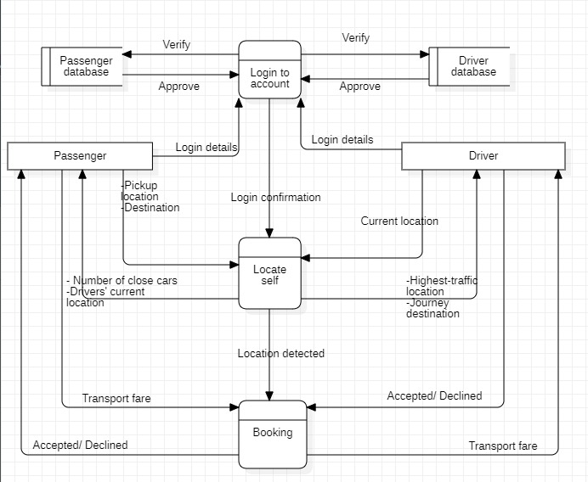
DATAFLOW DIAGRAM

Slide 8
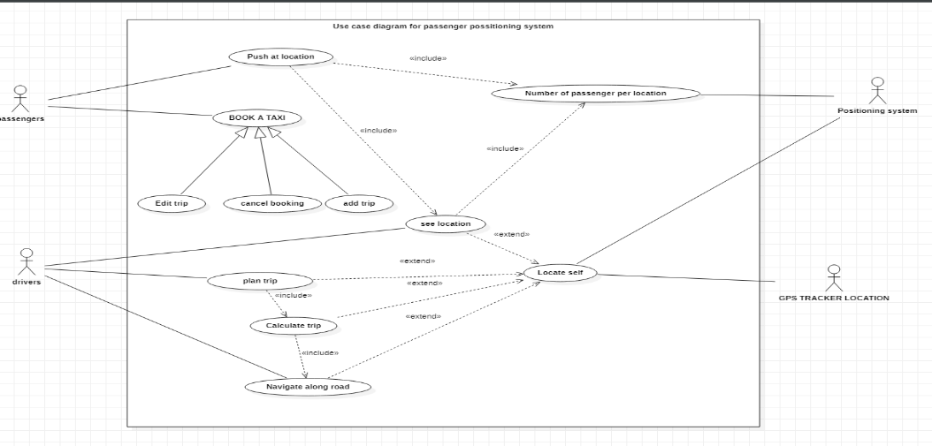
USE CASE DIAGRAM

Slide 9
DESIGN AND IMPLEMENTATION CONSTRAINTS
TECHNICAL CONSTRAINTS
SCALABILITY CONSTRAINTS
USER INTERFACE CONSTRAINTS
SECURITY
CONSTRAINTS

Slide 10
SYSTEM REQUIREMENTS
NON-FUNCTIONAL REQUIREMENTS
FUNCTIONAL REQUIREMENTS

Slide 11
Passengers should be able to specify their locations and destinations in the app
.
The app should provide direction to easiest path in reaching the passengers
FUNCTIONAL
REQUIREMENTS
Drivers should be able to view the location of passengers in the app
Future Passengers Should be able to cancel a booked taxi
Application should be able to differentiate between hired taxi and freelance taxi
The Application should be able to run on various platforms
.

Slide 12
NON-FUNCTIONAL REQUIREMENTS
AVAILABILITY
COMPATIBITY
SECURITY
USABILITY.

Slide 13
DOMAIN REQUIREMENTS
Domain requirements reflect the environment in which the system operates, so when we talk about an application domain, we talk about an application domain, we mean environments for operating and building the applications

Slide 14
DOMAIN REQUIREMENTS
01
02
03
04
Development framework
Programming language
Integrated Development Environment
Database

Slide 15
A TAXI FOR EVERYONE
Thank You

